Slide 1

Naive Bayes: The Deceptively Simple Classifier
A probabilistic machine learning algorithm that's both beautifully simple and surprisingly powerful for real-world classification tasks.

Slide 2
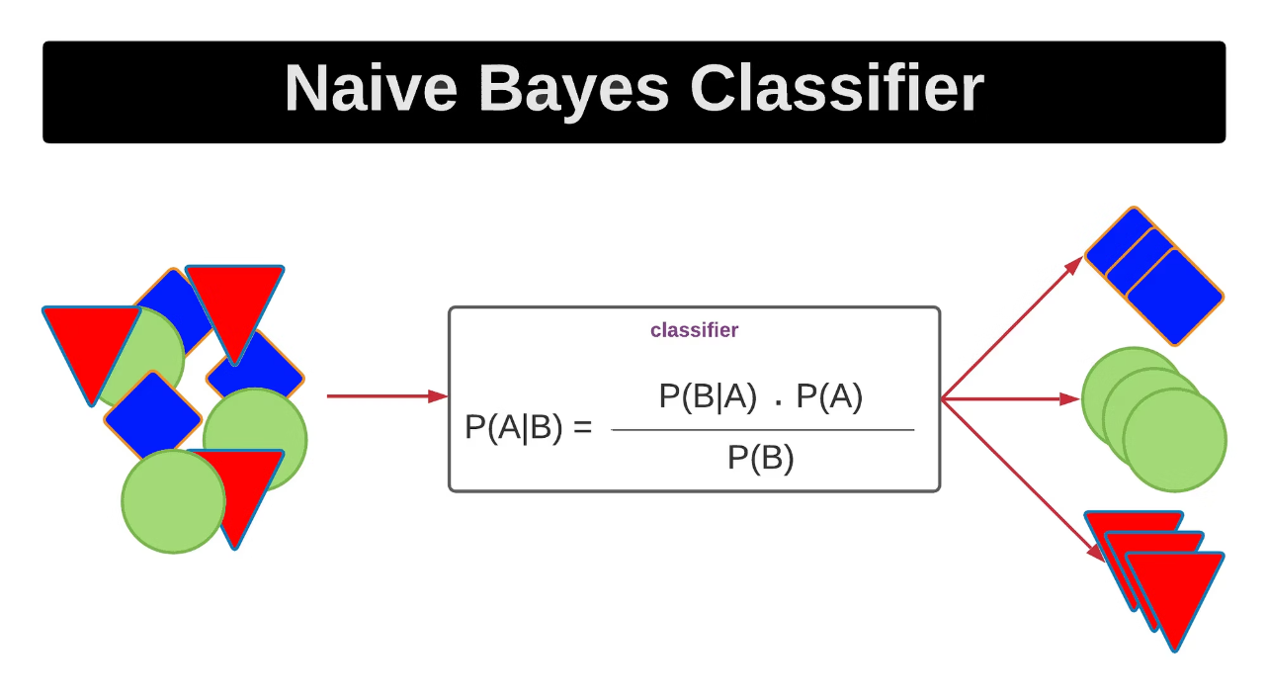
What is Naive Bayes?
Naive Bayes is a probability-based classifier that predicts the class with the highest likelihood given your features. It's built on Bayes' Theorem and makes one bold assumption: all features are independent of each other.
This independence assumption is charmingly optimistic—features in real data are rarely independent—but somehow, the algorithm still works remarkably well.

Slide 3
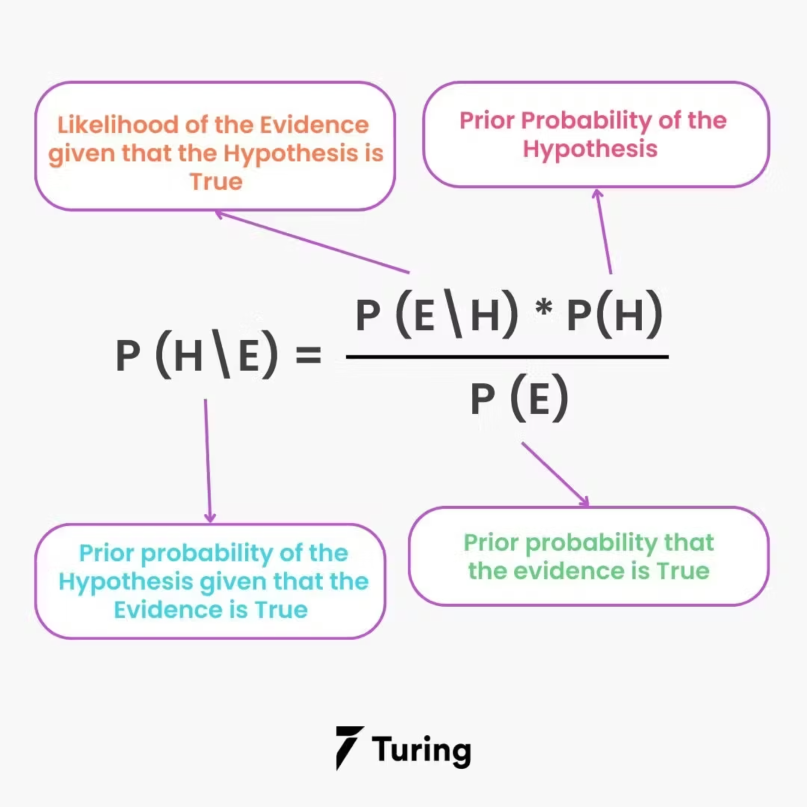
The Core Idea: Flipping Bayes' Rule
01
Observe the features
You have data points with multiple attributes
02
Compute P(Class | Features)
Calculate the probability of each class given those features
03
Pick the winner
Choose the class with the highest posterior probability
The question Naive Bayes answers: "If I see these features, which class is most likely?"

Slide 4



Why "Naive"? The Independence Assumption
The Assumption
Reality Check
The Surprise
All features are independent given the class label
Words in a sentence are clearly related and context-dependent
Despite this naive view, the model performs exceptionally well in practice

Slide 5

Intuition: Spam Detection Example
Imagine an email with:
"offer"
"lottery"
"prize"
Naive Bayes treats each word as independent, multiplies their individual spam probabilities together, and—boom—the spam probability shoots up.

Slide 6






Strengths vs. Weaknesses
Blazing fast
Lightweight
Trains and predicts in milliseconds
Minimal memory and computational needs
High-dimensional hero
NLP champion
Handles thousands of features effortlessly
Shines in text classification and spam filtering
Weaknesses ⚠️
Unrealistic independence
Struggles with correlation
But still wins
The core assumption doesn't hold in many real scenarios
Not ideal for correlated numeric features
Often outperforms complex models in NLP despite its simplicity

